Slide 1
It’s Fun to Code!
What is Programming and how do I Start?

Slide 2
Where is Code?
Where do we see code?
We see it in everyday life, whether it be in your smartphone, computer, car, or even in the check-out line at the grocery!

Slide 3
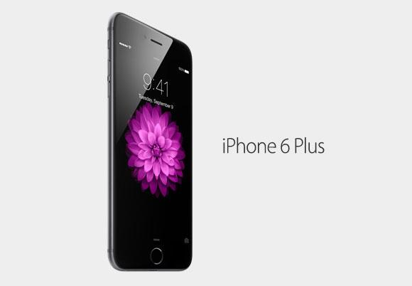
Apple iPhone

Slide 4
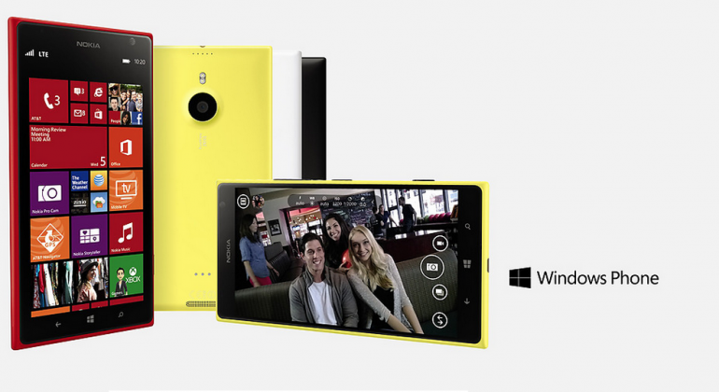
Windows

Slide 5
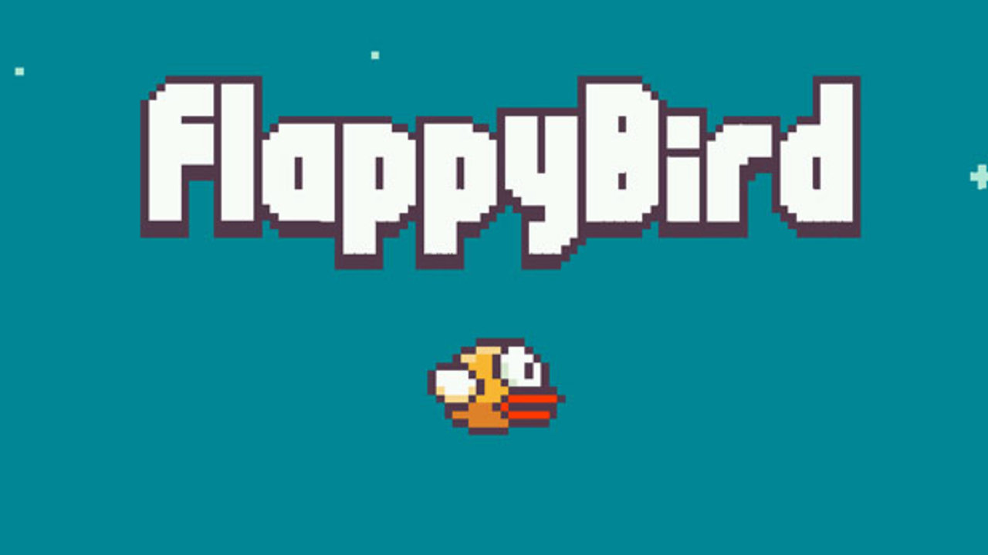
Apps

Slide 6
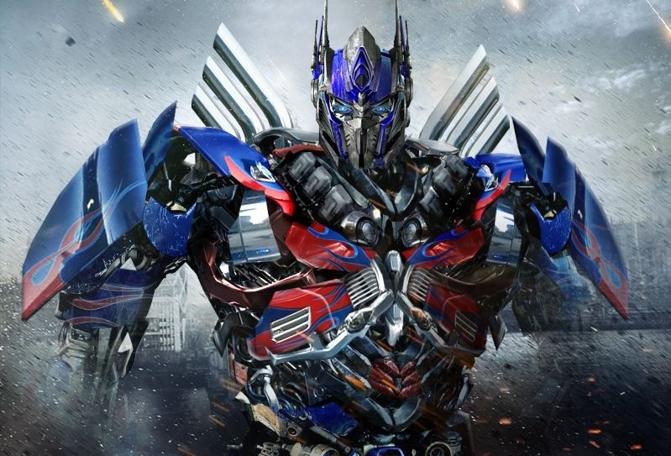
Robots?

Slide 7
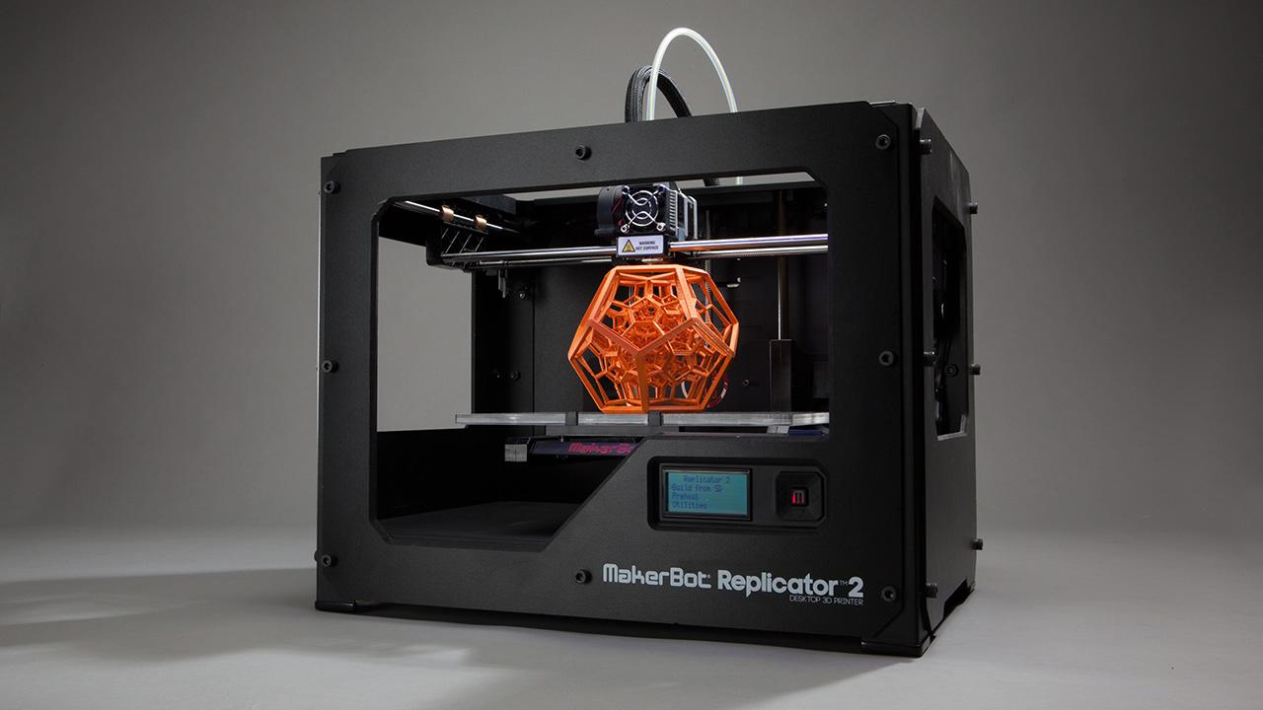
One of my favorites, 3D Printers

Slide 8
What does it look like?
Most coding languages use the alphabet, numbers, and special symbols (like math operators + - % / *)

Slide 9
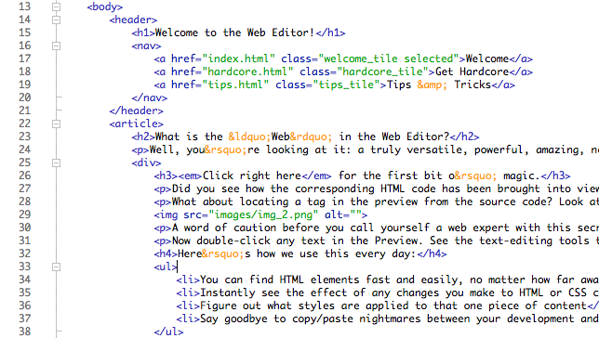
HTML

Slide 10
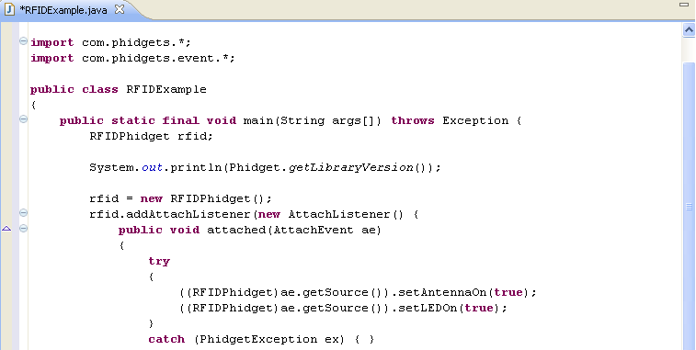
Java

Slide 11
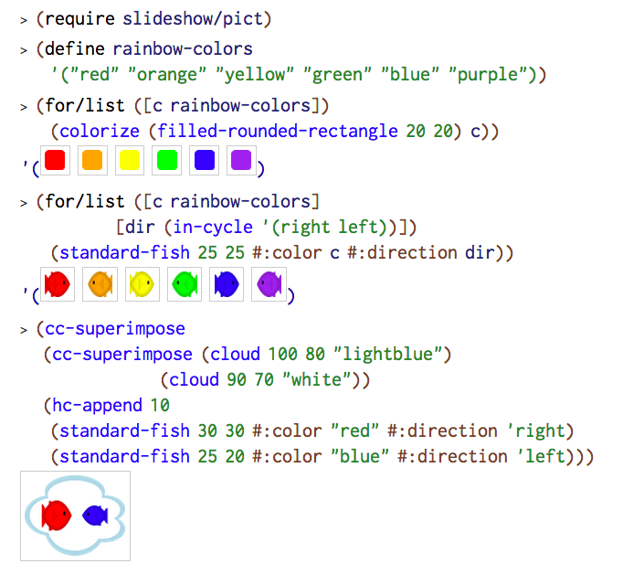
Racket

Slide 12
Why would I want to learn to code?
Last year, U.S.News ranked “Software Developer” and two other Computer Science jobs in the Top 10 Best Jobs to have.
Coding is practical.
Coding can be fun!

Slide 13
Think about this...
Would you rather do the same task, like adding a list of 100 numbers, 100 times…
Or take a minute to write a small bit of code to do it for you in an instant?

Slide 14
Programming can be fun!
Game design
Software engineering
Robotics
Apple and Microsoft
All these jobs can be fun!

Slide 15
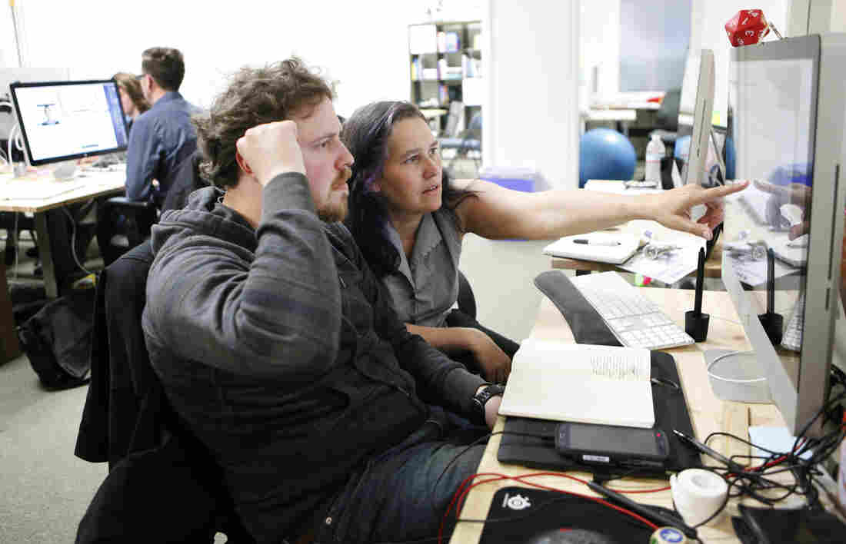

Slide 16
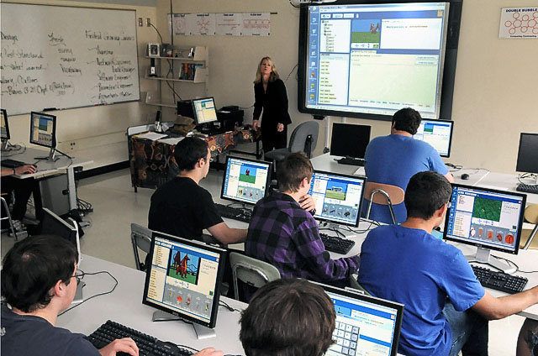

Slide 17
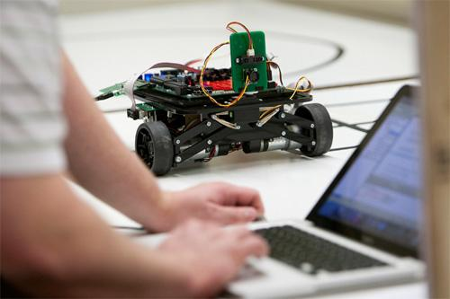

Slide 18
What can I do to start coding?
www.code.org Hour of Code
Find a beginner book for an easy language
(I recommend Dr.Racket or Python)
www.KidsRuby.com Games, Puzzles, Homework

